Slide 1
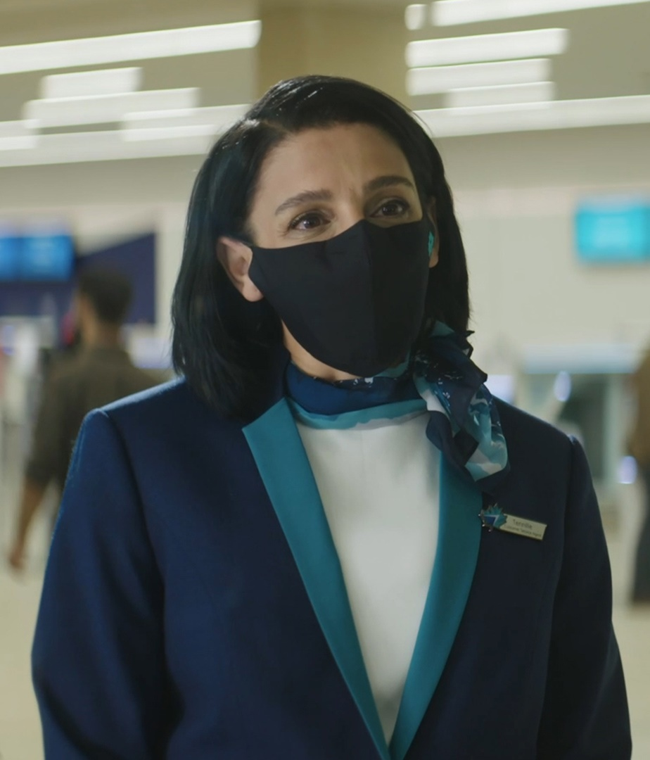
Travel Ready Video Series
While travel looks a little different now, our new Travel
Ready video guest-journey series will help prepare you and your clients for every stage of the next journey with us. From before they depart to after they arrive and at every point in between, we have their well-being at heart and will
always put their Safety Above All. Click below to view each video:
Preparing at home | Entry requirements | COVID-19 Travel Insurance
At the airport | In the air | WestJet Vacations

