Slide 1
Association changes Remarks and Wallet
Overview

Slide 2
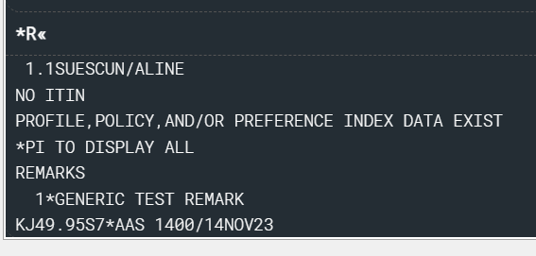
PNAPNR ON – Remark Sample from Sabre Profile
Remark comes with a * in the beginning of the field :
In the Graphical version, remark has an extra column named “Traveler Association” and the passenger it associates with:
IMPORTANT:
Only remarks moved to the PNR by Sabre Profiles will be automatically associated.

Slide 3
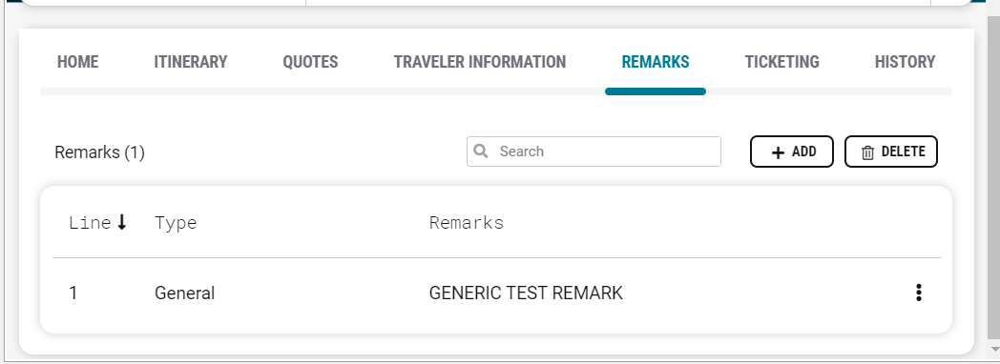
PNAPNR OFF – Remark Sample from Sabre Profile
No * in front of the line item:

Slide 4
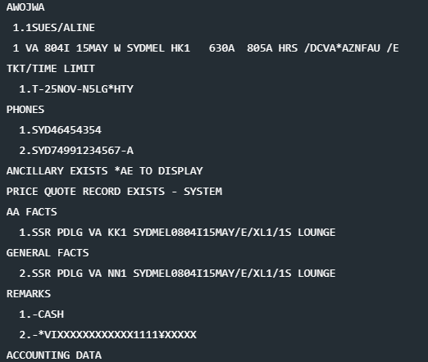
PNAPNR OFF – SR360 display – “5-”
Credit card data added with 5- command.
In SR360 display, no *FOP field is created, and form of payment data is added directly to the PNR display under Remarks
With PNAPNR OFF, I’m not able to add the form of payment information using FOP command in SR360:

Slide 5
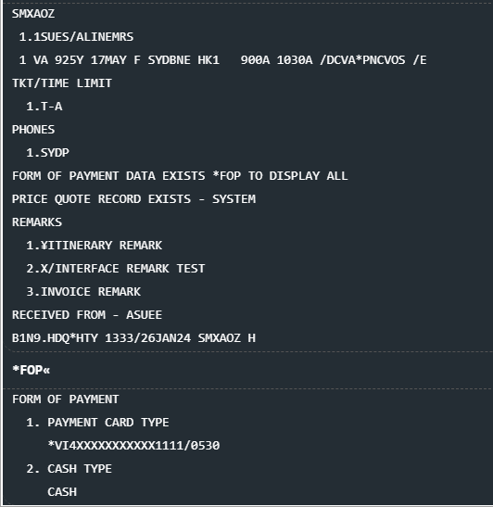
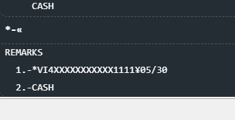
PNAPNR ON – SR360 display – “5-”
Credit card data added with 5- command.
For an undefined period, Sabre will still display the 5- remark in the PNR, although it won’t be explicit in the Remarks area. This “hidden” remark can be accessed by the command *-

Slide 6
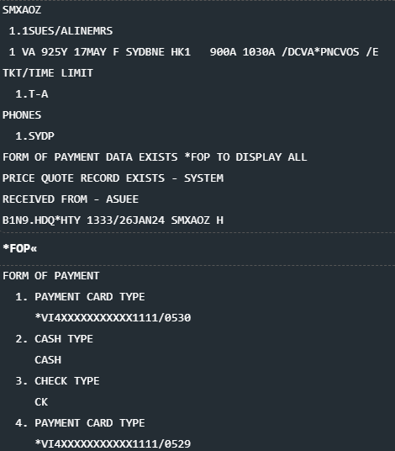
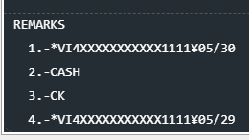
PNAPNR ON – SR360 display – “FOP”
Form of Payment data added using FOP command:
When adding the Form of Payment using the FOP entry in SR360, Sabre will still display the form of payment in both *FOP and *-
In this example, FOP 3 and FOP4 were added using command FOPCK and FOP*VI4444333322221111#05/29

Slide 7
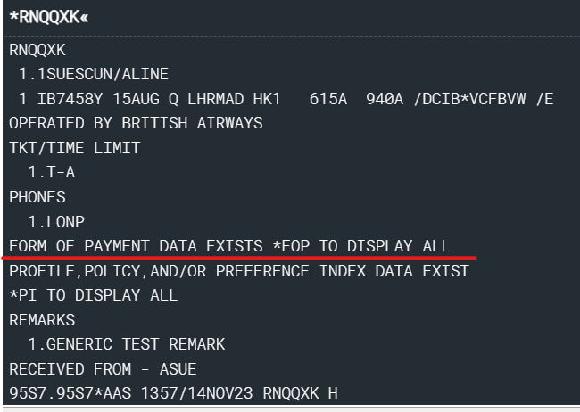
PNR created PNAPNR OFF and retrieved ON
System will convert the 5- data into a FOP field.
PCC OFF
PCC ON

Slide 8
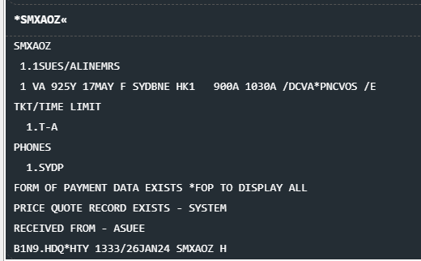
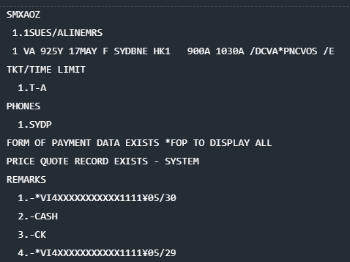
PNR created PNAPNR ON and retrieved OFF
PCC OFF will show a FOP field, but the 5- remarks will be expanded by default.
PCC ON
PCC OFF

Slide 9
IUR won’t change for remarks below
Regular text remarks will not be associated in the IUR. For those remarks nothing changes.

Slide 10
IUR will change for remarks below
Interface, Invoice and Itinerary remarks MOVED FROM PROFILES TO PNR will be affected.
IMPORTANT:
If those remarks are manually added to the PNR, they won’t be automatically associated, hence no IUR impact.

Slide 11
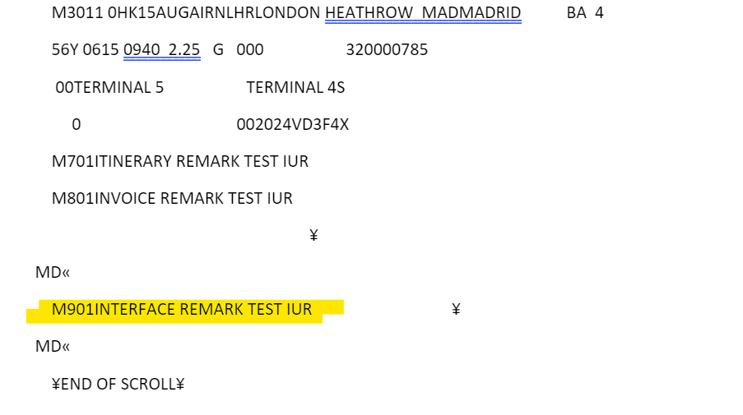
IUR will change for remarks below
IUR sample of non-associated remarks
For unassociated remarks, field M7, M8 and M9 will come alone in the IUR, no extra indication of association.

Slide 12
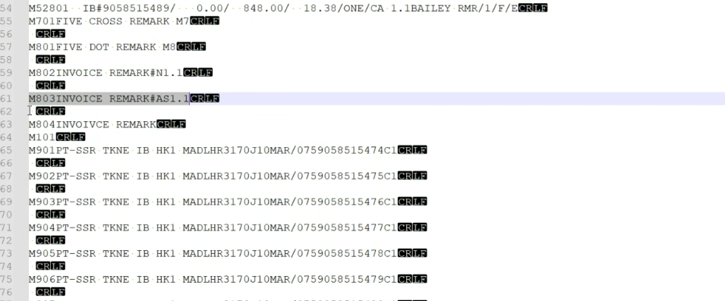
IUR will change for remarks below
IUR sample of associated remarks (remarks from Profile)
For associated remarks, field M7, M8 and M9 will have an extra M101 line, referring to the association – passenger N1.1

Slide 13
API services and Association capabilities
SOAP APIs

Slide 14
SOAP APIs that currently support Wallet
GetReservationRQ (V1.15.0 and >)
https://developer.sabre.com/docs/soap_apis/management/itinerary/Retrieve_Itinerary
UpdateReservationRQ (V1.15.0 and >)
https://developer.sabre.com/docs/soap_apis/management/itinerary/Update_Itinerary
TravelItineraryReadRQ (V3.8.0 and >)
https://developer.sabre.com/docs/soap_apis/management/itinerary/Get_Itinerary
OTA_AirPriceLLSRQ (V 2.14.0 and >) (PCC R2FH and OZ77 using older versions)
https://developer.sabre.com/docs/soap_apis/air/book/Price_Air_Itinerary
OTA_AirTicketLLSRQ (V2.9.0 and >)
https://developer.sabre.com/docs/soap_apis/air/fulfill/Issue_Air_Ticket

Slide 15
SOAP APIs that currently support Wallet
EnhancedAirBookRQ (V3.7.0 and >)
https://developer.sabre.com/docs/soap_apis/air/book/orchestrated_air_booking
Copy Sabre Profile to Itinerary
https://developer.sabre.com/docs/soap_apis/profiles/build_reservation/Copy_Profile_to_Itinerary
SabreCommandLLSRQ (V2.0)
https://developer.sabre.com/docs/soap_apis/management/utility/Send_Sabre_Command

Slide 16
GetReservationRQ

Slide 17
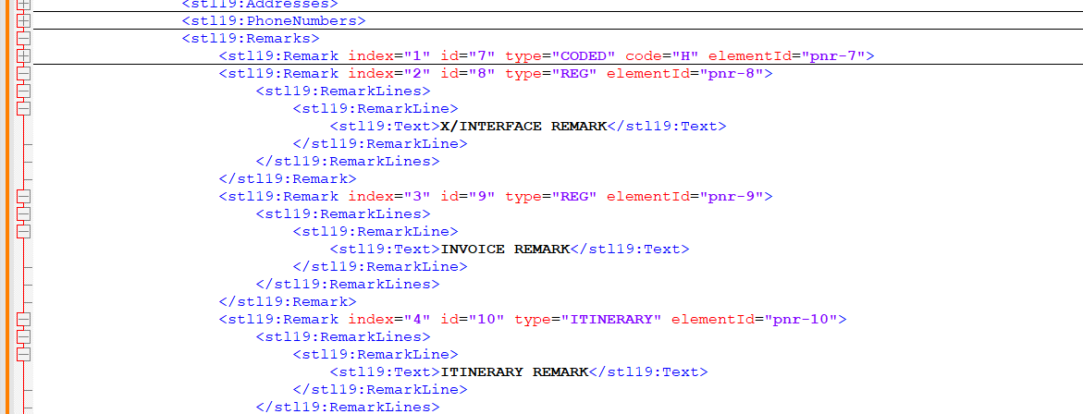
PNAPNR OFF –Associated Remarks
When PNAPNR is OFF, there won’t be association of remarks, and they will be displayed under Remarks.

Slide 18
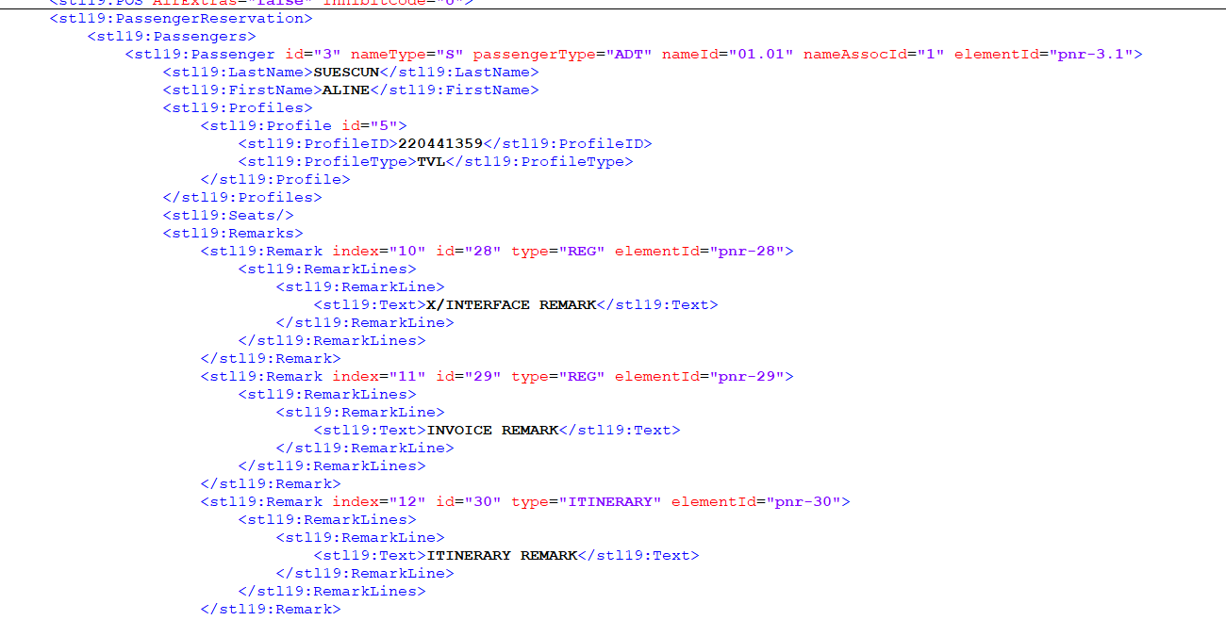
PNAPNR ON - Associated Remarks
Associated Remarks are added to the API in PassengerReservation>Remarks field
Those remarks are NOT added to the regular Remarks field.

Slide 19
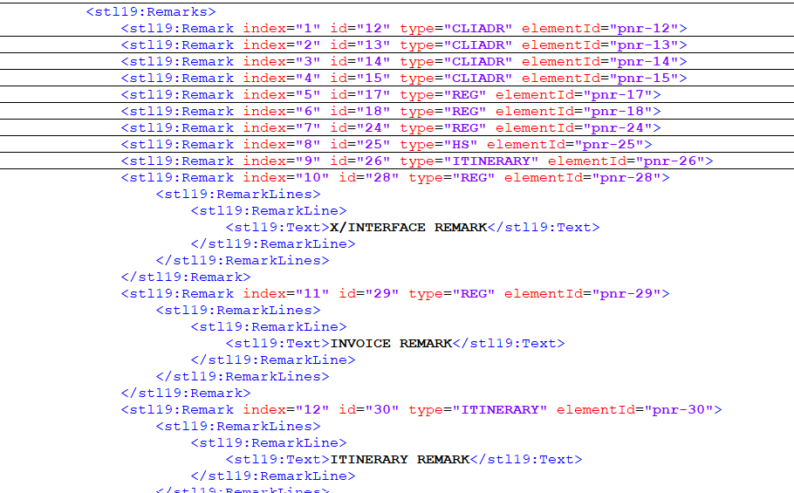
PNR created with PNAPNR ON and displayed on PNAPNR OFF PCC – Associated Remarks
Although the associated remarks were added to the PNR by a PNAPNR ON PCC, when retrieved on a PNAPNR OFF PCC using GetRes SOAP, it will revert the display to the regular Remark field.
Those remarks are NOT added to the PassengerReservation>Remarks field in this situation.

Slide 20
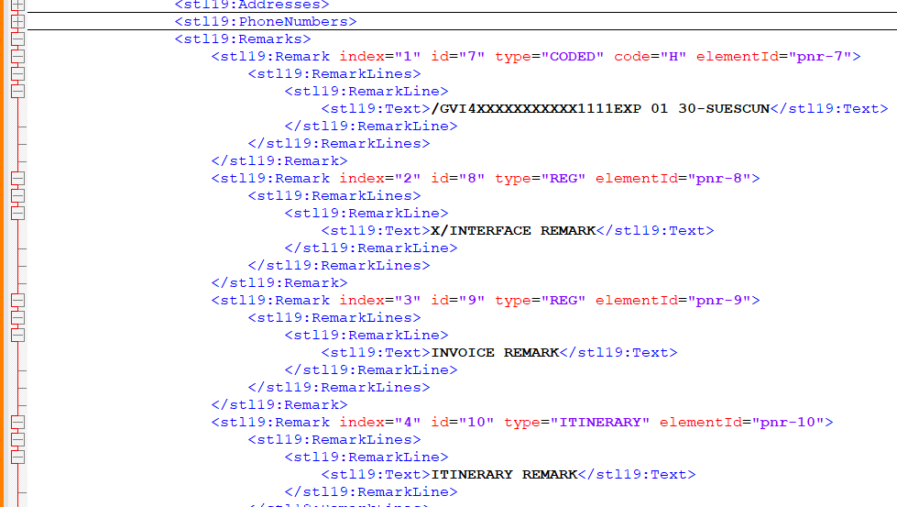
PNR created with PNAPNR OFF and displayed on PNAPNR ON PCC - Associated Remarks
Remarks will be displayed in Remarks field.
Those remarks are NOT added to the PassengerReservation>Remarks field in this condition.

Slide 21
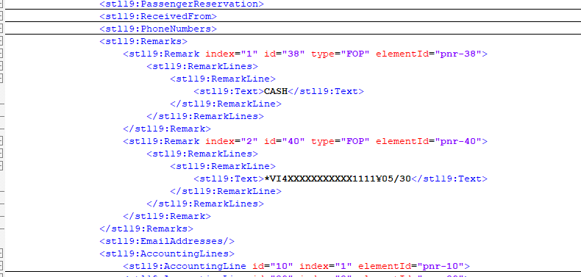
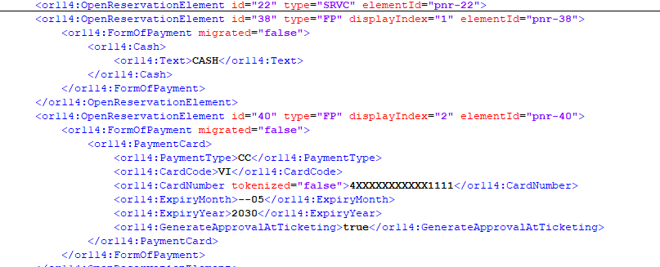
PNAPNR OFF – Form of Payment
Form of payment displayed in the Remarks field
Form of payment displayed in OpenReservation>Form of Payment

Slide 22
PNAPNR ON – Form of Payment
Form of payment displayed in the Remarks field
Form of payment displayed in OpenReservation>Form of Payment

Slide 23
PNR created with PNAPNR OFF and displayed on PNAPNR ON PCC – Form of Payment
Form of payment displayed in the Remarks field
Form of payment displayed in OpenReservation>Form of Payment

Slide 24
PNR created with PNAPNR ON and displayed on PNAPNR OFF PCC – Form of Payment
Form of payment displayed in the Remarks field
Form of payment displayed in OpenReservation>Form of Payment

Slide 25
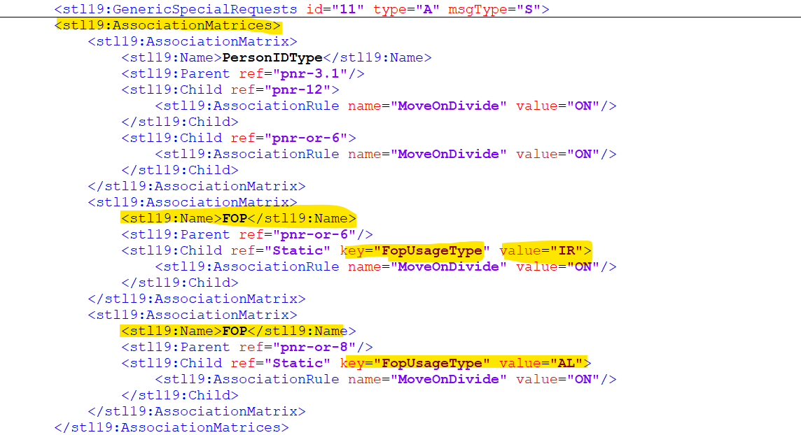
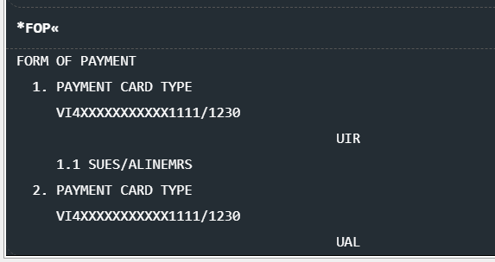
PNAPNR ON - FOP Type Association – IUR and Air

Slide 26
UpdateReservationRQ

Slide 27
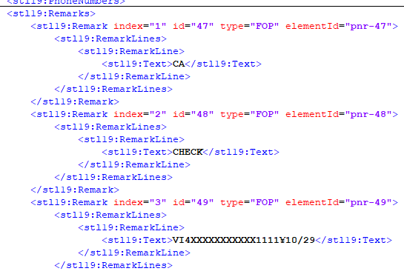
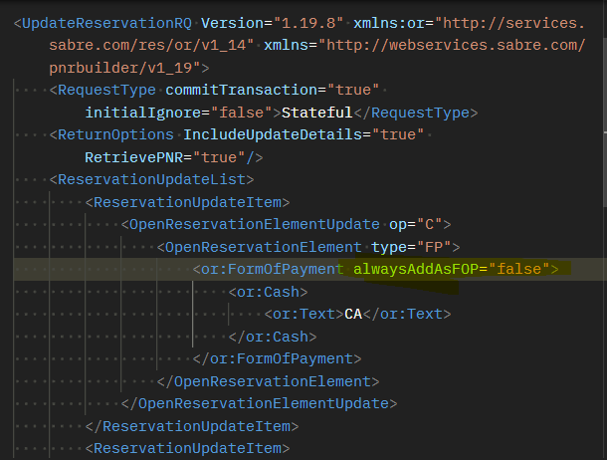
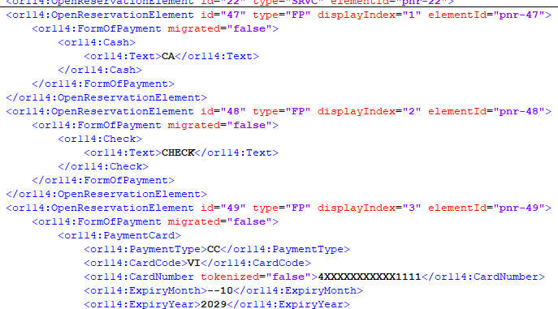
PNAPNR OFF – Form of Payment
When “always add as FOP” is set to false in the RQ, system will add both Remarks and Open Element data:

Slide 28
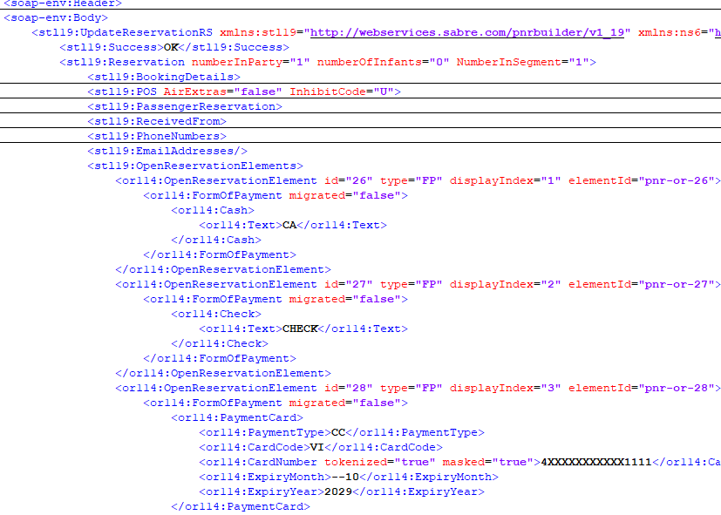
PNAPNR ON – Form of Payment
When “always add as FOP” is set to false in the RQ, system will add information only to Open Reservation > FOP field

Slide 29
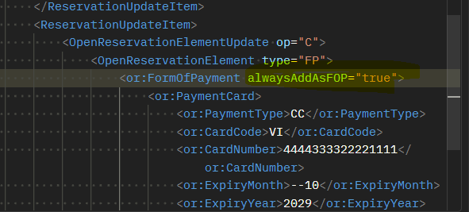
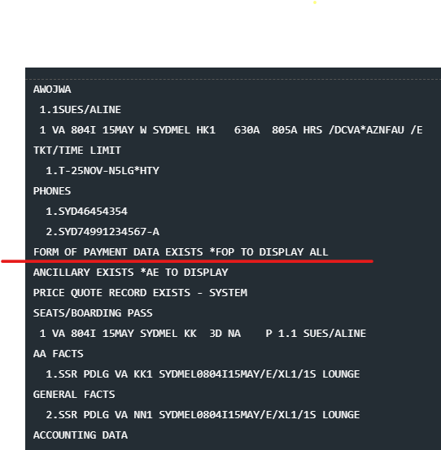
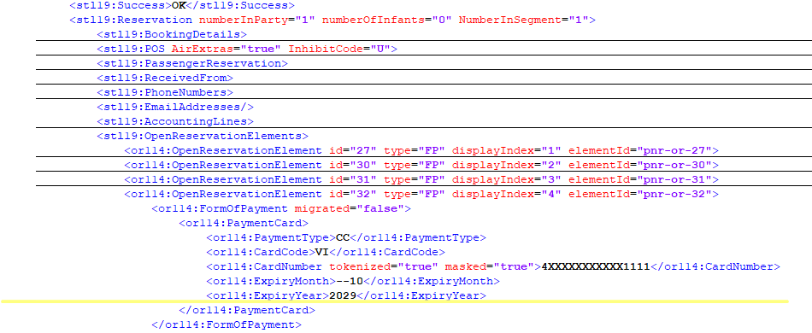
PNAPNR OFF – Form of Payment
When “always add as FOP” is set to true in the RQ, system will only add OpenReservation FOP EVEN IF THE PCC IS PNAPNR OFF
When this FOP field is created, it can’t be edited/deleted since PCC is OFF. It can be cancelled by a PCC ON.

Slide 30
PNAPNR ON– Form of Payment
When “always add as FOP” is set to true in the RQ, system will only add OpenReservation FOP EVEN IF THE PCC IS PNAPNR OFF
UNDER INVESTIGATION

Slide 31
TravelItineraryReadRQ

Slide 32
PNAPNR OFF – Form of Payment
Form of payment information will come in the Customer Info as well as Open Reservation fields:

Slide 33
PNAPNR ON – Form of Payment
Form of payment information will come in the Customer Info as well as Open Reservation fields:

Slide 34
PNR created with PNAPNR OFF and displayed on PNAPNR ON PCC – Form of Payment
Form of payment information will come in the Customer Info as well as Open Reservation fields:

Slide 35
PNR created with PNAPNR ON and displayed on PNAPNR OFF PCC – Form of Payment
Form of payment information will come in the Customer Info as well as Open Reservation fields:

Slide 36
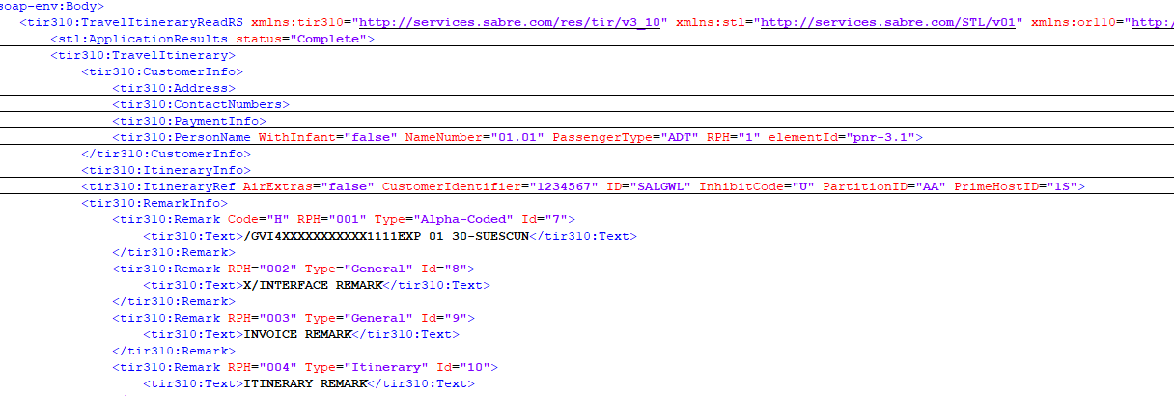
PNAPNR OFF - Associated Remarks
Associated Remarks are added to the API in the Remarks field, with no mention to the passenger. The same behavior applies to PNRs in both mixed environments – ON>OFF and OFF>ON

Slide 37
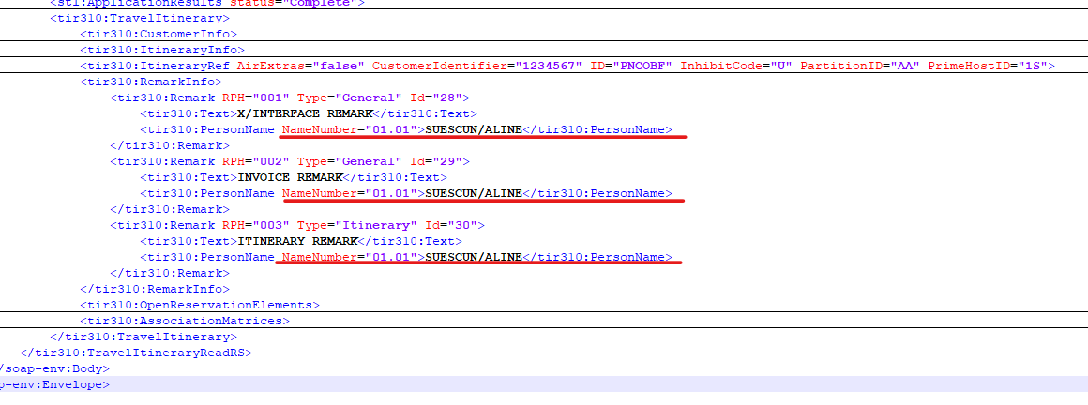
PNAPNR ON - Associated Remarks
Associated Remarks are added to the API in the Remarks field, with the Passenger Association details on the same field.

Slide 38
PNAPNR ON - Associated Remarks
2 passengers on the PNR, each one with its own association:

Slide 39
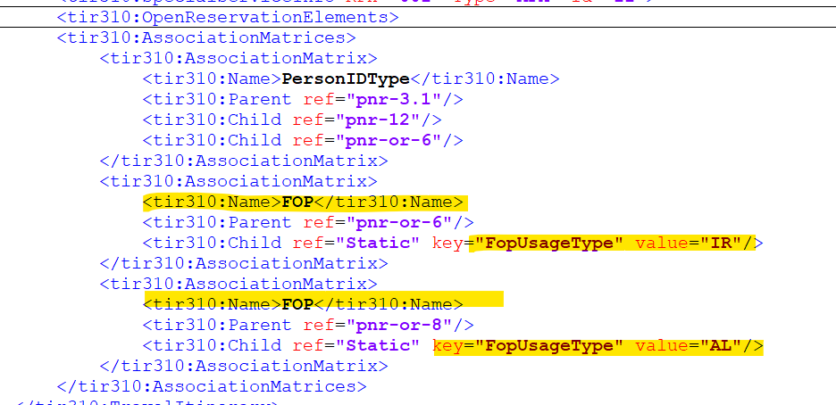
PNAPNR ON – FOP Type Association – IUR and Air

Slide 40
OTA_AirPriceLLSRQ & EnhancedAirBookRQ (Orchestrated)

Slide 41
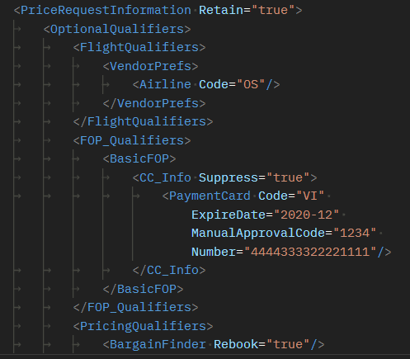
PNAPNR OFF - Form of Payment
Currently, you can pass the Form of Payment during Air Price transaction under FOP_Qualifiers>BasicFOP
It can be any valid form of payment.

Slide 42
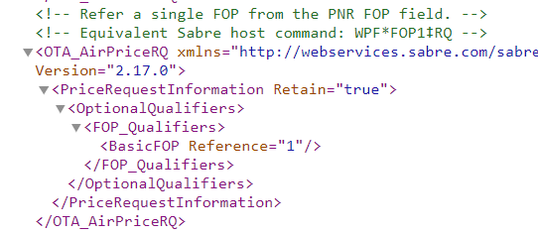
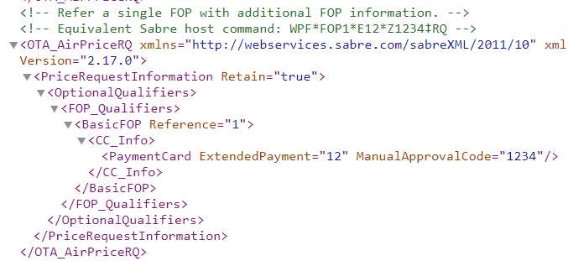
PNAPNR ON - Form of Payment
The Form of Payment in this API can be consumed as a reference to the information already present in the PNR.
System will still accept any other form of payment such as CC, Cash, etc., if it is fully described in the request, as current. The old format will not go away.
Check all the possible combinations using the wallet (FOP) in Dev Studio: https://developer.sabre.com/docs/soap_apis/air/book/Price_Air_Itinerary/resources

Slide 43
OTA_AirTicketLLSRQ

Slide 44
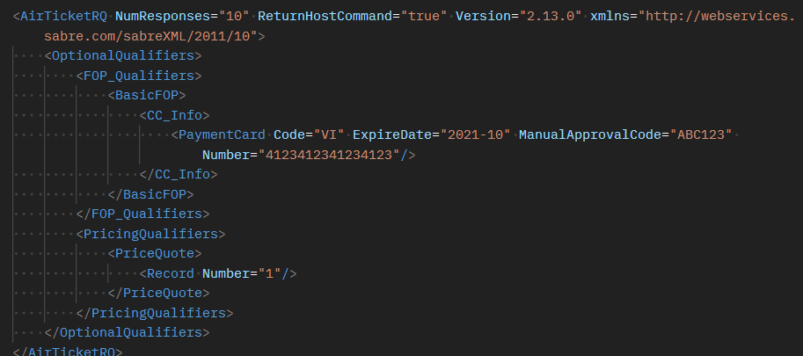
PNAPNR OFF - Form of Payment
When OFF, the API will require the full information about the Form of Payment to be present in the call.

Slide 45
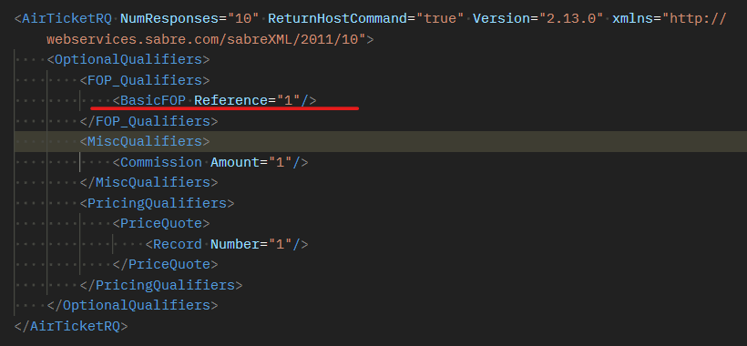
PNAPNR ON - Form of Payment
The Form of Payment in this API can be consumed as a reference to the information already present in the PNR.
System will still accept any other form of payment such as CC, Cash, etc., if it is fully described in the request, as current. The old format will not go away.

Slide 46
EPS_EXT_ProfileToPNRRQ Copy Profile to PNR

Slide 47
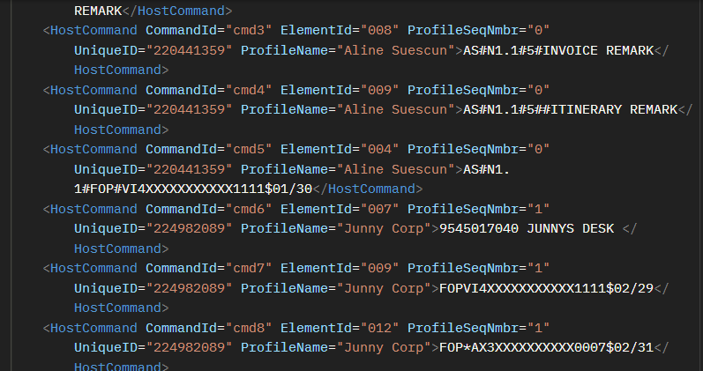
Profile Move to PNR – ON x OFF
ON OFF
When PCC is ON, association of remarks happens automatically, and the association command AS# is passed to the PNR. Also, the Form of Payment in the Traveler Profile goes to the PNR associated.
No association happens in the PCC OFF.

Slide 48
SabreCommandLLSRQ

Slide 49
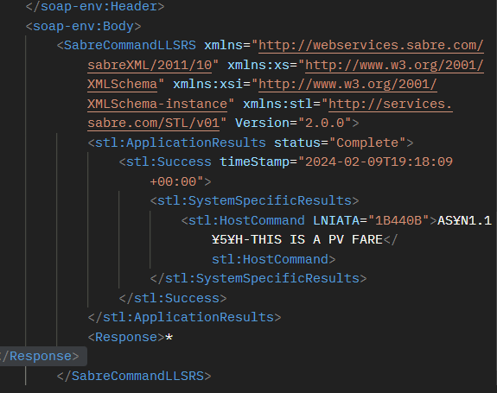
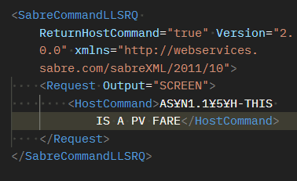
SabreCommandLLSRQ – Associated Remarks
Remarks can be “manually” associated using cryptic commands. Find association formats in the page: https://central.sabre.com/s/article/add-name-associated-pnr-fields-as

Slide 50
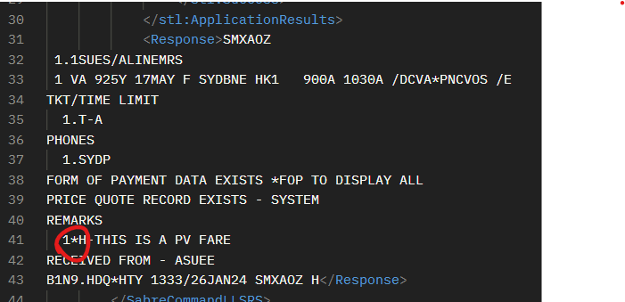
SabreCommandLLSRQ – Associated Remarks
Display shows the * indicating the remark association.

Slide 51
API services and Association capabilities
REST APIs

Slide 52
REST APIs that currently support Wallet
GetBooking
https://developer.sabre.com/docs/rest_apis/trip/orders/booking_management
CreateBooking
https://developer.sabre.com/docs/rest_apis/trip/orders/booking_management
Create Passenger Name Record
https://developer.sabre.com/docs/rest_apis/air/book/create_passenger_name_record
Enhanced Air Ticket
https://developer.sabre.com/docs/rest_apis/air/fulfill/enhanced_air_ticket

