Slide 1
Aer Lingus
Overview of Products and Services

Slide 2
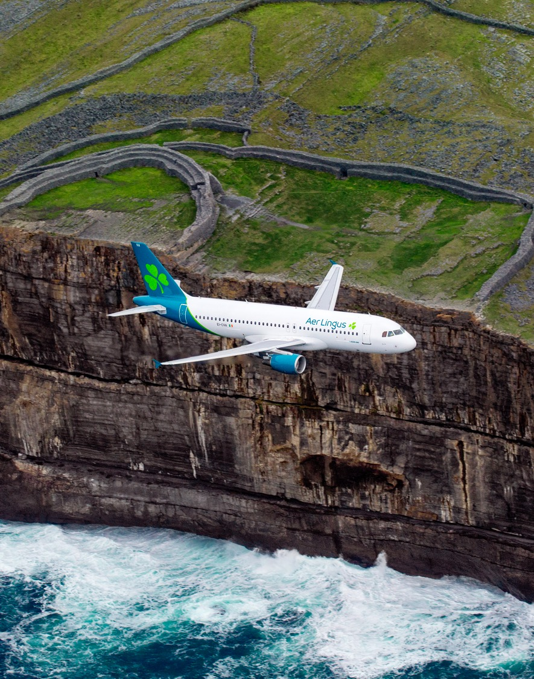
A commitment to value
Our mission: To be the leading value carrier across the North Atlantic
We have refreshed our brand offering
a contemporary personality
Improved cost and productivity has enabled Aer Lingus to maintain competitive pricing
Growth of share and services on long-haul

Slide 3
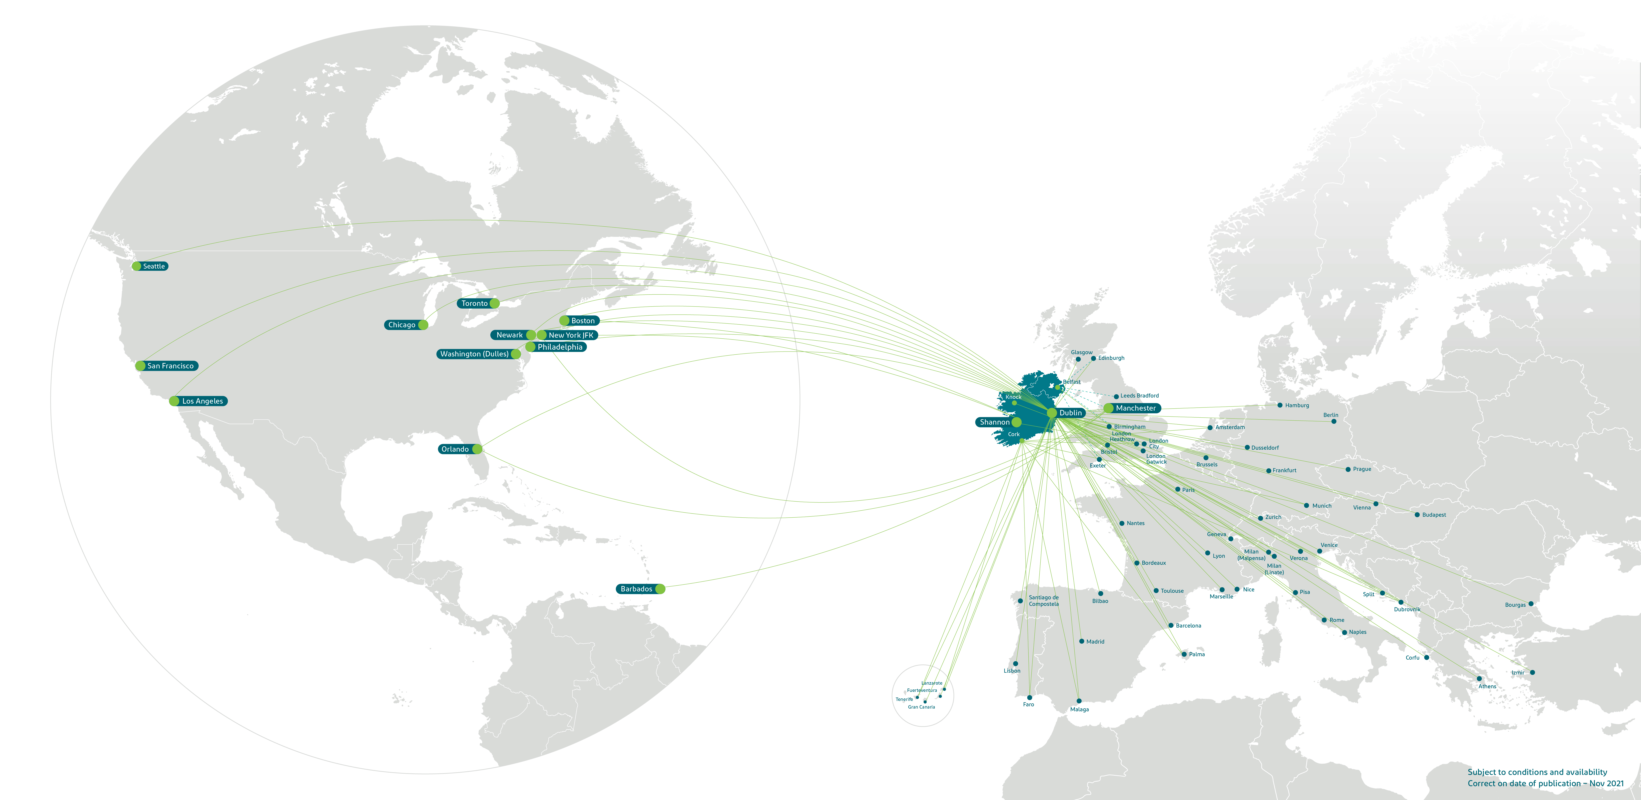
The Dublin Gateway
– Connecting North America and Europe

Slide 4
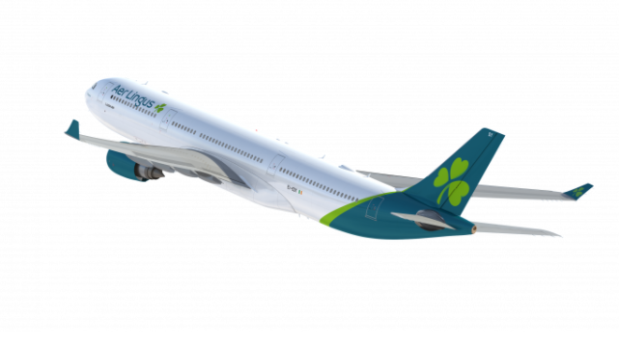
An International airline proud to be Irish
Aer Lingus has been connecting Ireland to North America for over 60 years and has carried an estimated 40 million transatlantic customers +
Early flights were populated mostly with those emigrating from Ireland and over the year Aer Lingus has played a huge role continuing to connect Irish diaspora to their native land
Aer Lingus has evolved from an Irish airline that flies internationally to an international airline that is proud to be Irish, something that our North American customers will experience as soon as they book with us and step on board
Our recent refreshed brand, reflects our position as a modern, contemporary airline but also allows customers who have always loved our brand to maintain a positive affiliation

Slide 5
Products and Services

Slide 6
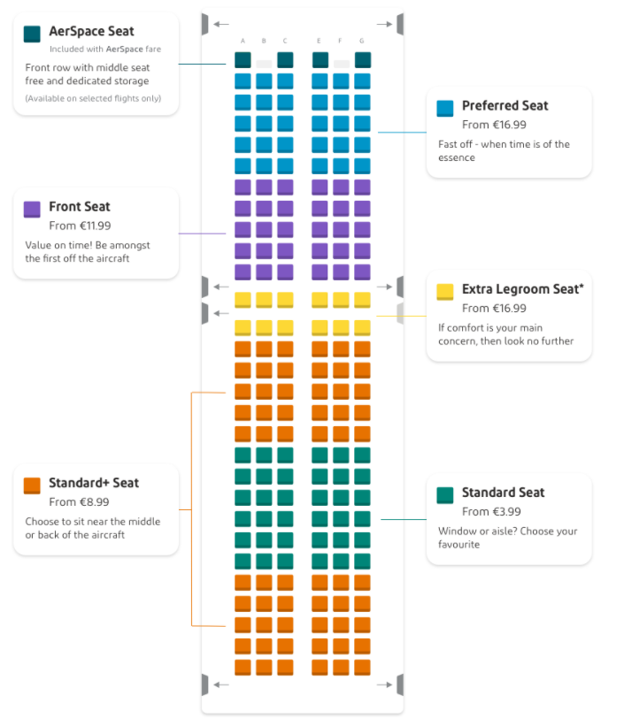
Flights within Europe
All-Economy class cabin, with the addition of AerSpace* on certain routes and various retail options for pre-selection of seats at varying price points based on location in the cabin
*AerSpace: premium short-haul fare designed to give customers more space to work and relax in the front row of the cabin, along with lounge access and Fast Track airport security
Our A321NeoLR operates certain business short-haul routes (e.g. DUB-LHR), with Business Class seats sold as AerSpace
Customers can choose from a range of food and beverage options to purchase from our on board menu Bia
PressReader, offers customers over 7,000 digital newspapers & magazines, with the level of access based on fare type
New carry-on bag policy launching in summer 2021 with limited allocation of overhead locker space on-board (on the basis of entitlement or purchase online). Free option to drop-off at check-in, charge applies if gate-checked

Slide 7

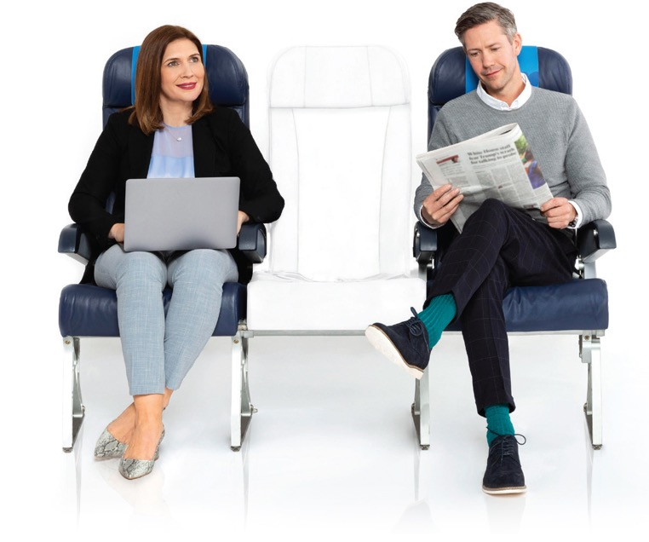
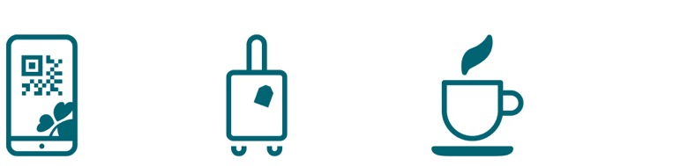
AerSpace product on short haul
Dedicated seating, with center seat always empty
20kg
Check-in
bag
Fast track
security
access at
Dublin Airport
Lounge
access
Priority
boarding
Dedicated
overhead
locker space
Complimentary food
and beverage on
board from our
Bia menu

Slide 8
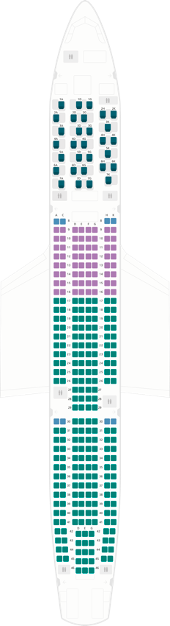
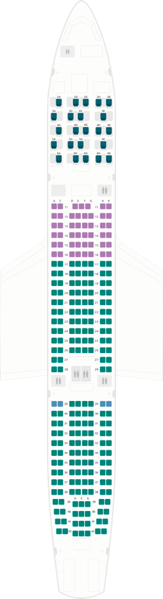
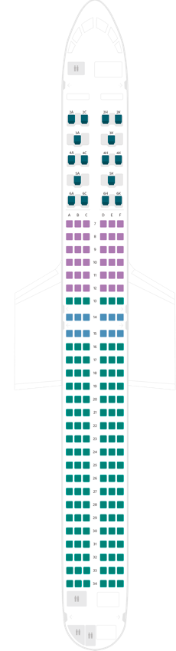
Transatlantic Flights – Economy Class
A330-300
Aircraft Economy
Seat pitch: 79–81cm
Seating: 2–4–2
Economy: 287
A330-200
Aircraft Economy
Seat pitch: 79–81cm
Seating: 2–4–2
Economy: 248
A321Neo
Aircraft Economy
Seat pitch: 79–81cm
Seating: 3–3
Economy: 162

Slide 9
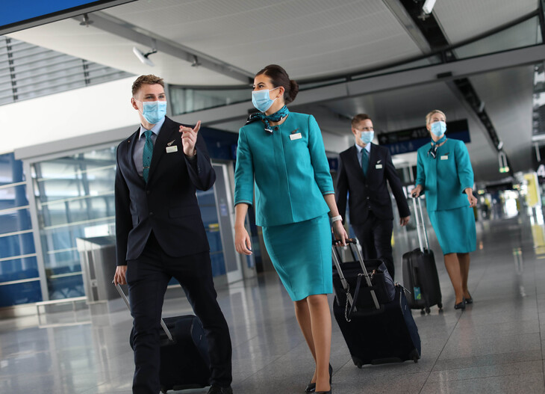
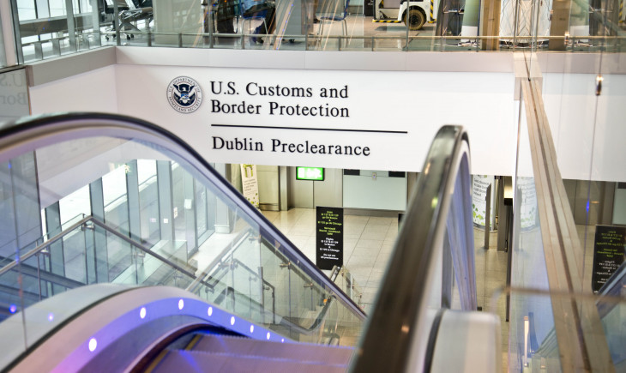
The smart way to travel
Top class entertainment including latest movie releases, TV boxsets, games, music and more
PressReader app, offers customers over 7,000 digital newspapers & magazines via their smart device
Wi-Fi available on board A330 and A321neo LR, keeping customers connected as they fly
Preclear U.S. Customs and Border
Protection (CBP) in Dublin Terminal 2
Complimentary hot meal, beverages and snack served in-flight. Customers can also choose from a range of food and beverage (incl. alcohol) options to purchase from our Bia buy-on-board menu

Slide 10
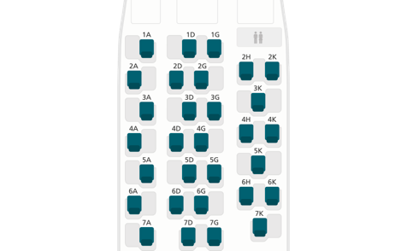
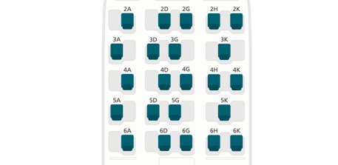
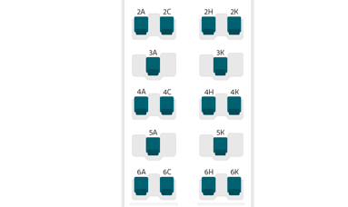
Transatlantic: Business Class
Fully lie-flat seats
16” HD touch screen
Wi-Fi onboard - with complimentary Wi-Fi access for 400MB of data and mobile network on A330
Premium inflight dining with the best of local cuisine and fine wines
Express meal service for those who would like to maximize their sleep
Customers can check-in up to three bags with a combined weight of 63Kg as well as availing of priority check-in and boarding, as well as having lounge access, in Dublin airport the 51st and Green lounge Pre-clearance in Dublin
A330-300
Aircraft Economy
Seat pitch: 147cm
Business: 32
A330-200
Aircraft Economy
Seat pitch: 147cm
Business: 23
A321Neo
Aircraft Economy
Seat pitch: 152cm
Business: 16

Slide 11
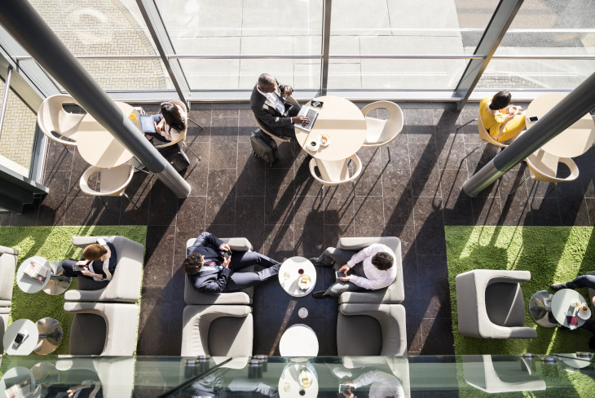
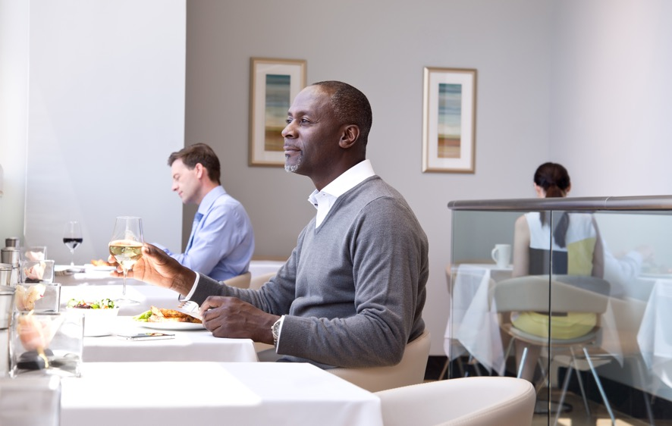
Aer Lingus Lounges
Signature lounges in Dublin, Heathrow
and JFK
Enjoy complimentary drinks and snacks,
as well as free Wi-Fi and unlimited PressReader access to 7,000+ digital newspapers and magazines
Order selected food and drinks from the comfort of your seat using the YourMenu site
Shower facilities also available
Relax in our quiet zone
Our barista serves fresh coffee between 4.15am and 7am in our Dublin lounge
Preflight dining for Business Class customers
in JFK lounge
Revival Lounge available in Dublin and New York (JFK) allowing transatlantic Business Class customers to refresh with a shower on arrival.

Slide 12
North American Lounges
North America
Please use virtual cursor to read the content.
Airport | Name | Location
Boston | The Club Lounge | Terminal C, next to gate C19
Chicago | British Airways Lounge | near Gate M11
Hartford | Escape Lounge | Terminal A
Los Angeles | Virgin Atlantic Lounge | Terminal 2, one level up from the main concourse
Newark | British Airways Lounge | Next to Gates B50-58
New York JFK | Aer Lingus Lounge | across from Gate 26
Orlando | The Club MCO | Airside Terminal A, close to gates 90-99
Philadelphia | British Airways Lounge | Opposite Gate A14
San Francisco | United Club Lounges | Mezzanine Level across from Gate 71A
Seattle | The Club at SEA | Terminal A , located beside gate A11
Toronto | KLM Lounge | Gate C32
Washington D.C. | British Airways Lounge | Gate B50

Slide 13
Loyalty

Slide 14
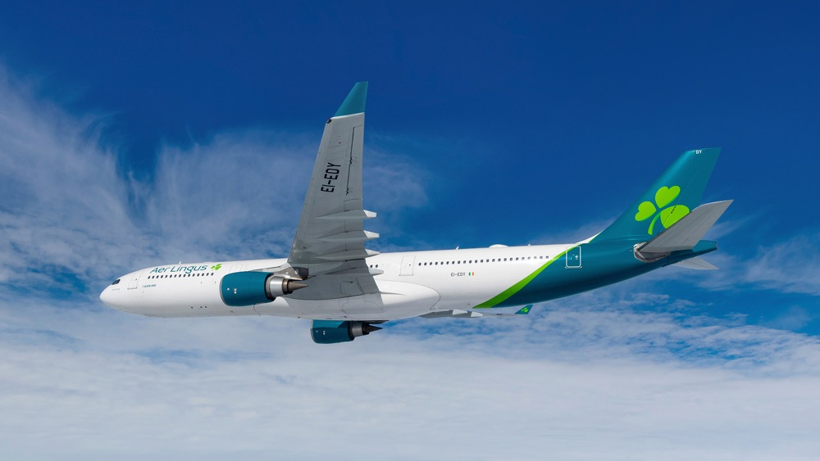
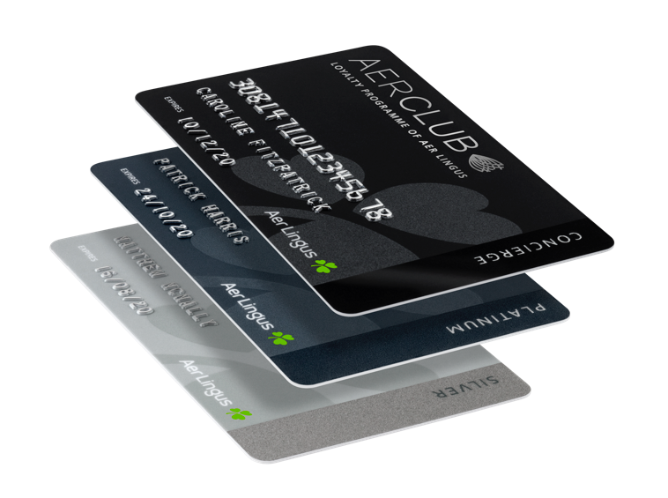
AerClub
At Aer Lingus we aim to offer a world class service and to meet the needs of the modern, international traveller. With this in mind, we developed AerClub, our loyalty programme, which allows customers to collect Avios points and earn Tier Credits when flying
Tiers: Green, Silver, Platinum & Concierge
Avios is the currency of AerClub
Avios collected can be turned into reward flights with Aer Lingus and AerClub airline partners. Avios are collected on flights, hotel stays, and in online retail outlets

Slide 15
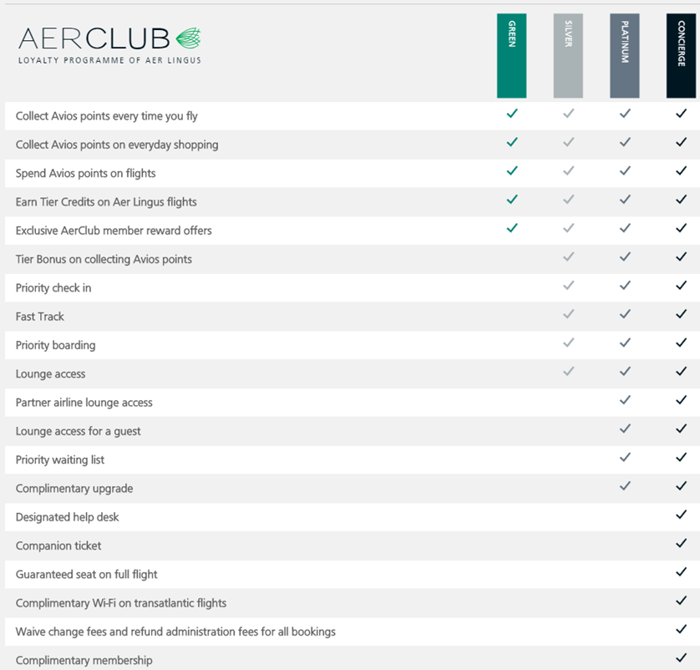
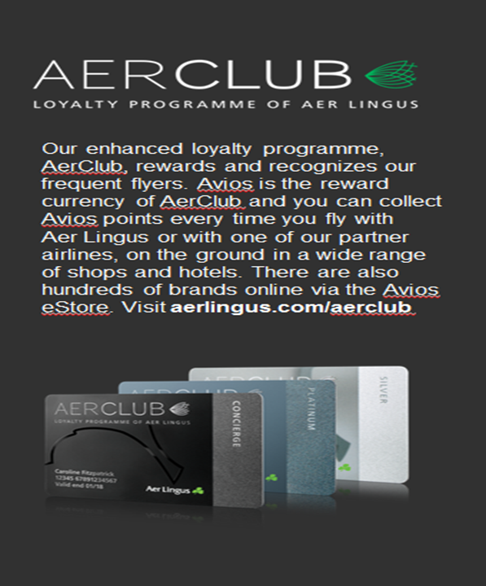

Aer Club & Skytrax 4 Star Airline

Slide 16
Keeping you healthy and
safe on your next trip
Your health and safety is our top priority. In light of Covid-19,
we’re introducing new measures to maintain our high standards
of health and safety.

Slide 17
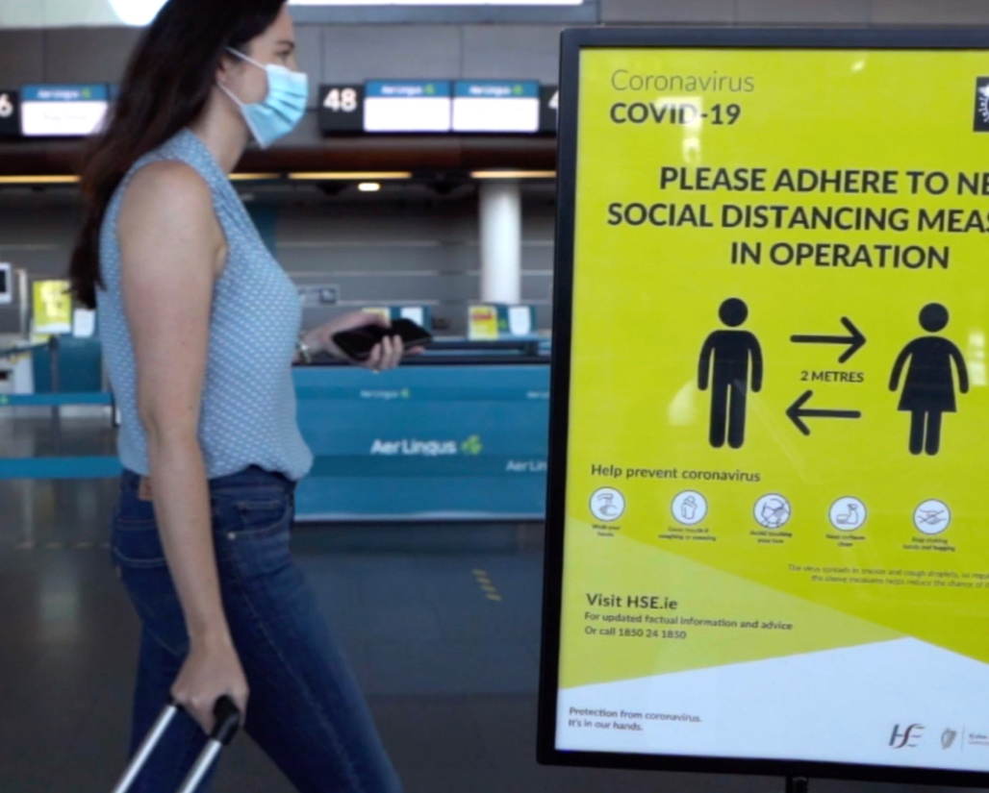
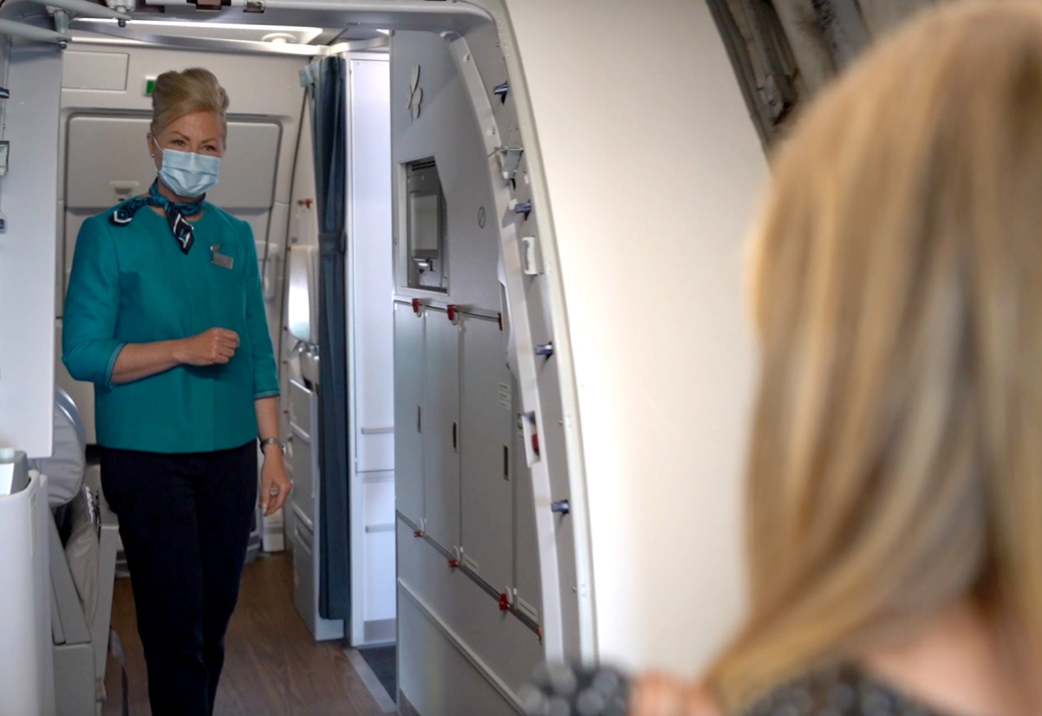

Safety Measures
The health and safety of our customers and people is our number one priority
In light of Covid-19, in May we introduced additional safety measures at all stages of the customer journey
These measures include;
    Mandatory wearing of face masks by all customers and crew
    Social distancing practiced at check in, boarding and disembarking
    Enhanced cleaning system
    State-of-the-art air filtration

Slide 18
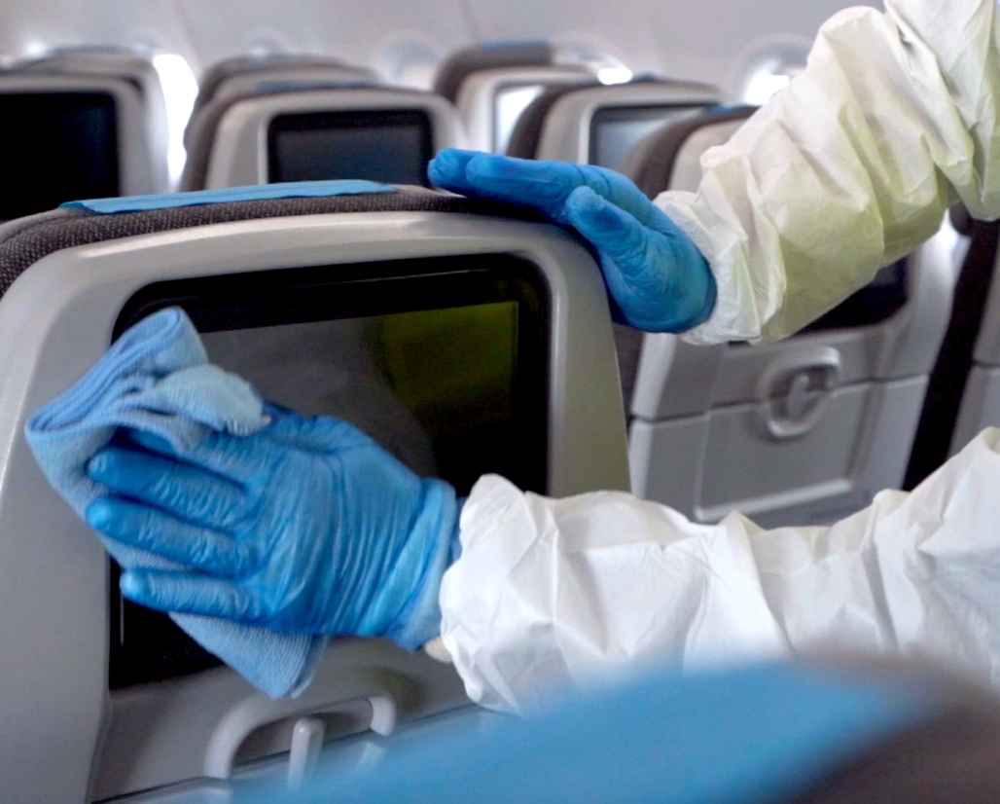


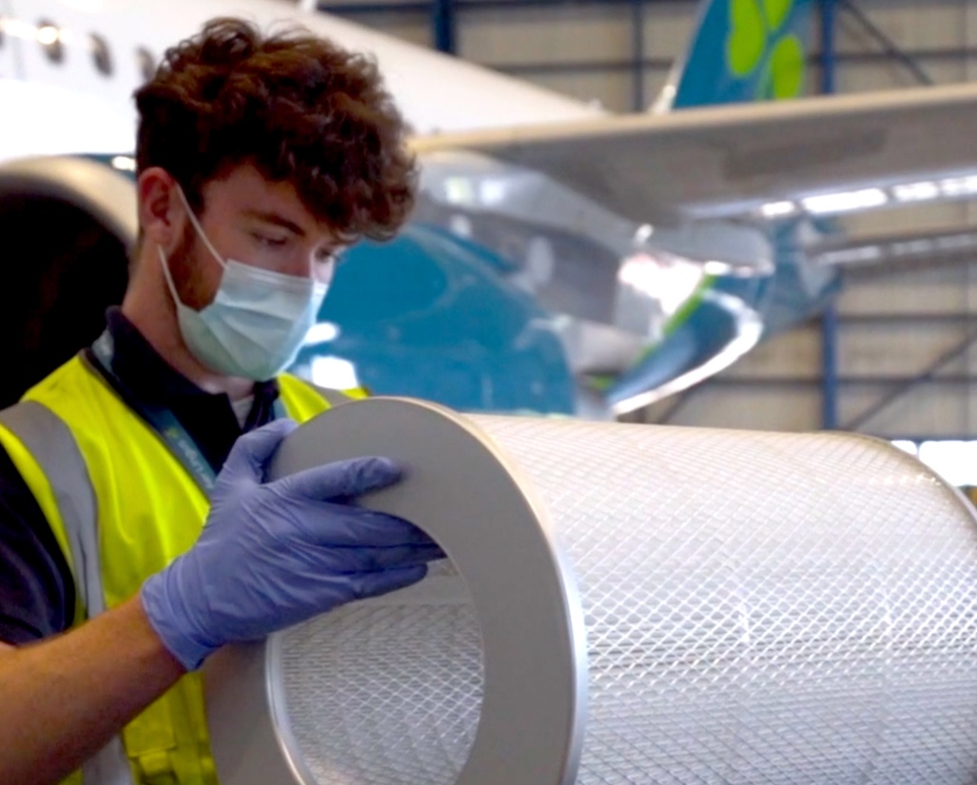
Cleaning and onboard filtration
Enhanced cleaning of our planes
Hospital-grade disinfectant is sprayed on all hard surfaces
Daily deep-cleaning of tray tables, arm rests and windows by hand
State-of-the-art air filtration
All of our Airbus aircraft are fitted with state-of-the-art air filtration technology to hospital standards
99.97% of particles are removed by this technology and cabin air is replaced every three minutes

Slide 19
Sustainability

Slide 20
Sustainability
At Aer Lingus, we are committed to a sustainable future.
Our flight path to a carbon neutral future.
We are part of IAG, the first airline group worldwide to commit to achieving net zero carbon emissions by 2050. The group will achieve a 10% reduction in CO₂ per passenger kilometre by 2025 and a 20% reduction by 2030.
Core to our environmental objectives is investment in new and modern aircraft. Our new Airbus 321neo LR aircraft are 20% more fuel-efficient than existing aircraft and produces 50% less engine noise versus the A321ceo.
As well as innovations and investments in more modern aircraft and technology we are committed to reducing aviation’s environmental impact and are investing in a range of global carbon reduction projects – such as rainforest protection and reforestation programmes, which our customers will also be able to offset their flight to, making their journey carbon neutral.

Slide 21
Innovation & Technology

Slide 22
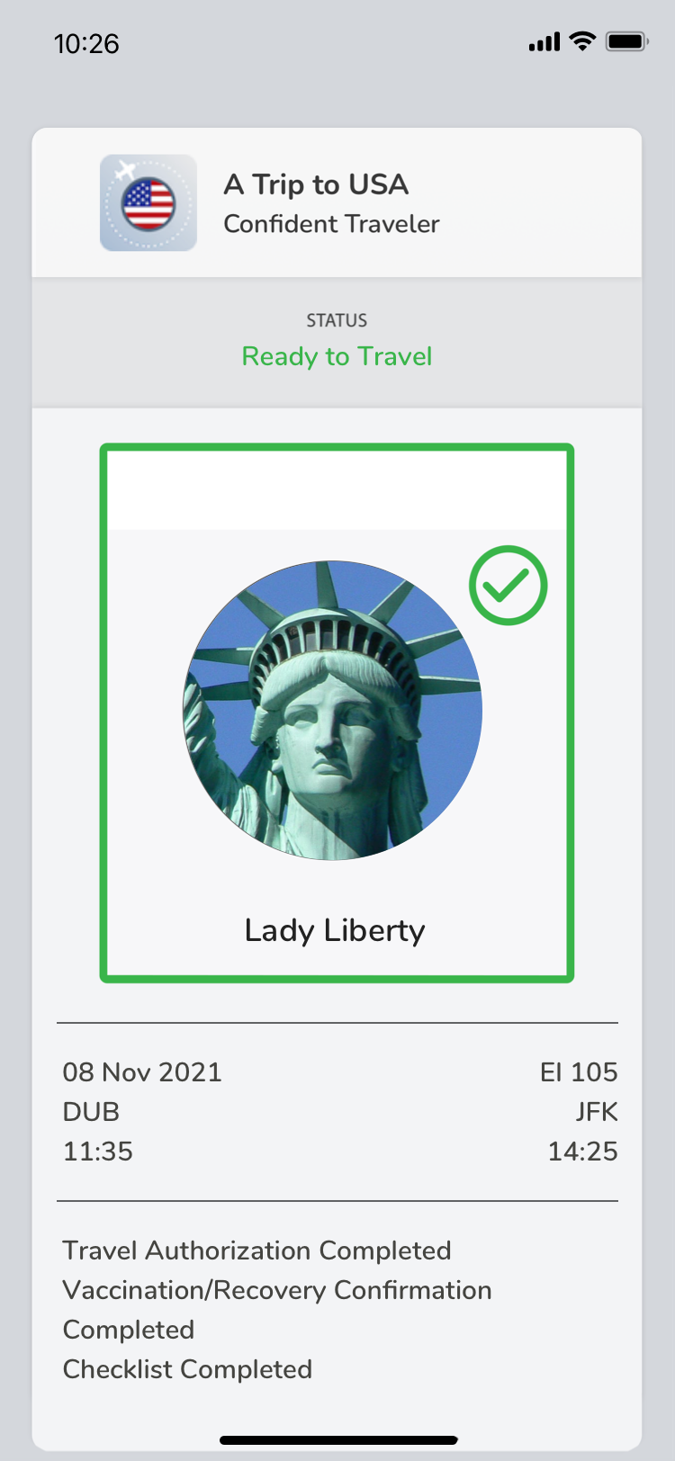
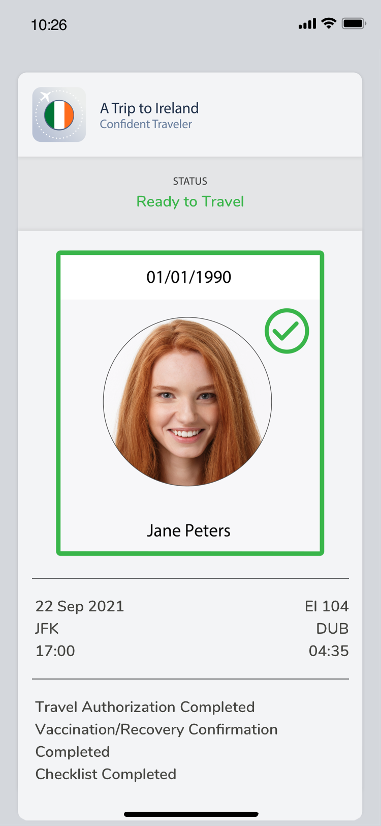
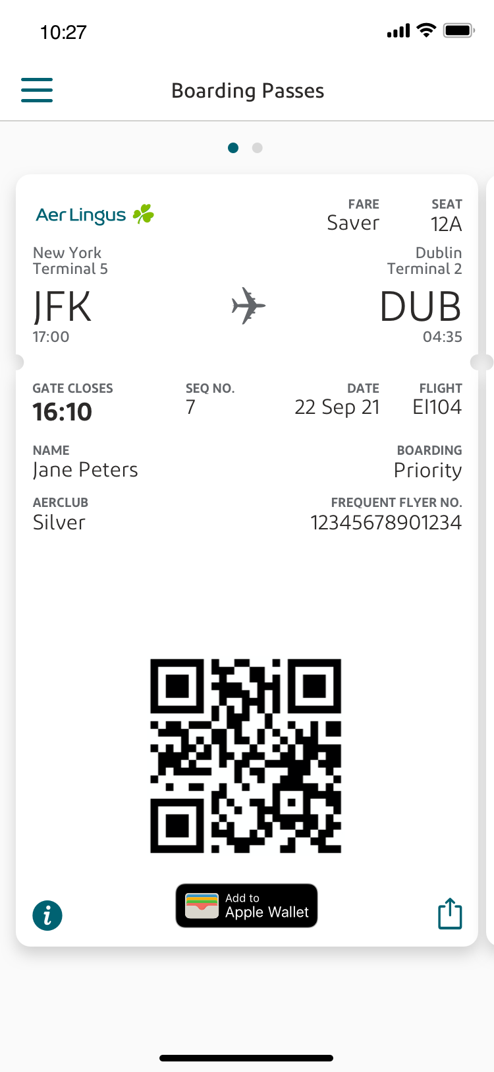
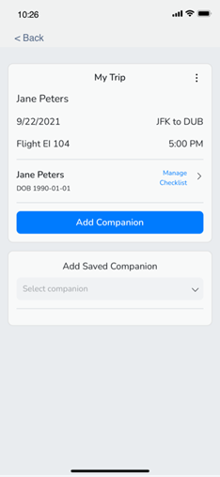
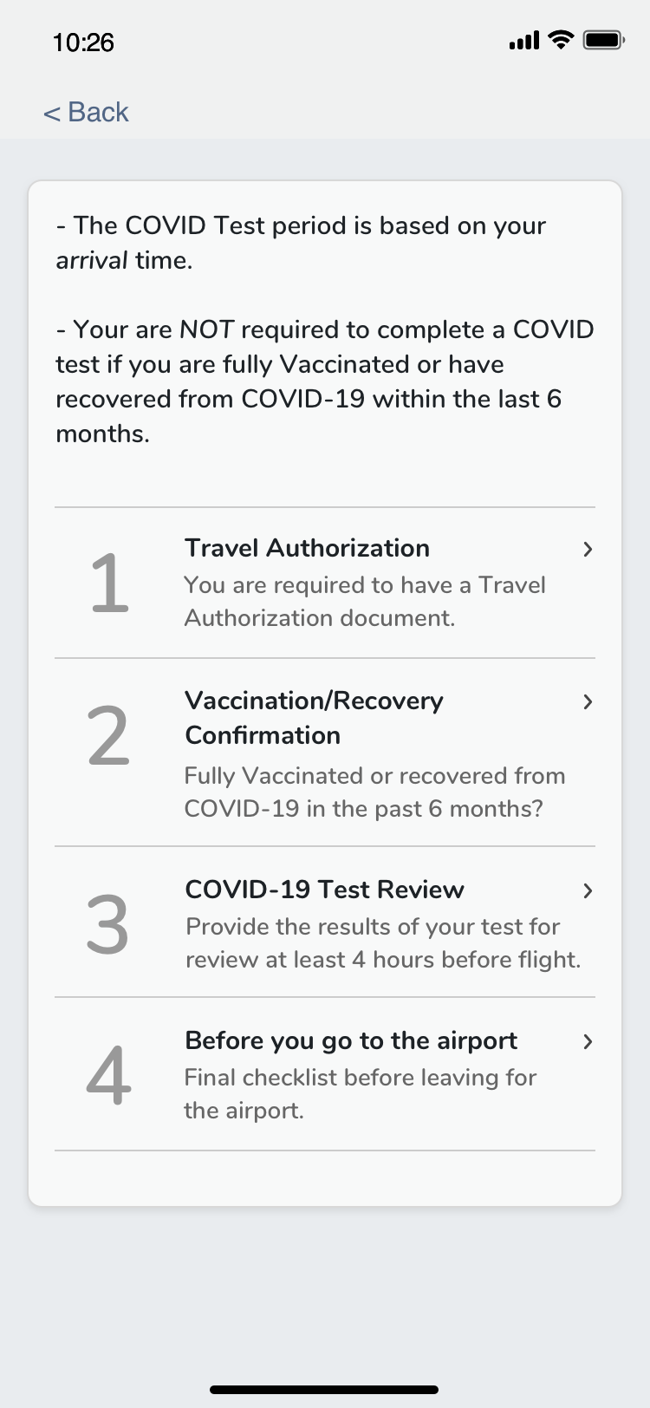
Ready to travel – Let’s fly with VeriFLY
Download VeriFLY app for free
Available on the majority of our network - must use for each flight / destination
VeriFLY must be used for to and from USA to allow for online check in (just show your online boarding pass)
For EU routes show your “green tick” and boarding pass
VeriFLY can be used for flight up to -4 hours to STD
All COVID related checks approved and you’re good to go.

Slide 23
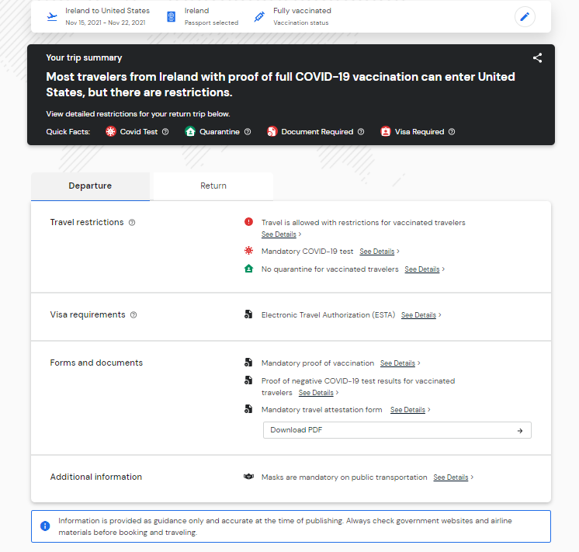
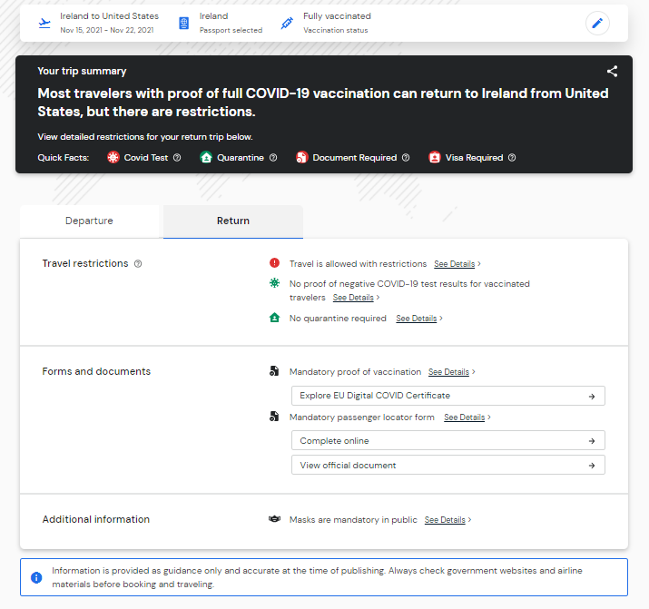
“Know before you go” – Sherpa support tool
Country requirements
Departure requirements
Return requirements
https://www.aerlingus.com/support/covid19-information/country-by-country-travel-information/

Slide 24
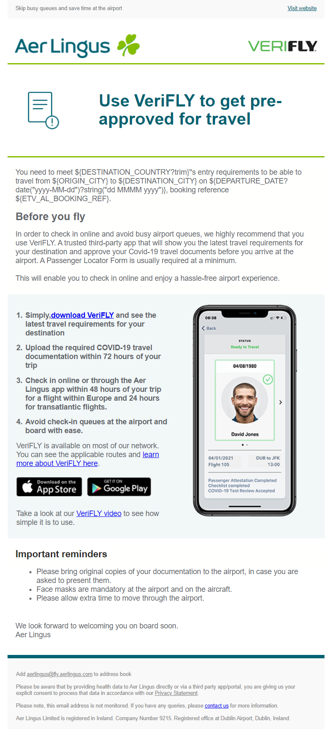
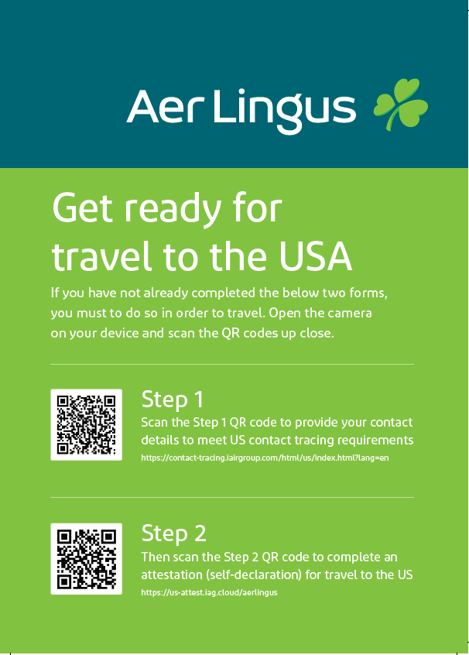
VeriLFY email and USA requirements
**Customers must have a contact tracing email receipt and if they did not use VeriLFY must also complete the online Attestation form.
Contact tracing link: https://contact-tracing.iairgroup.com/html/us/index.html?lang=en
Attestation link: https://us-attest.iag.cloud/aerlingus

Slide 25
Thanks!

